Slide 1
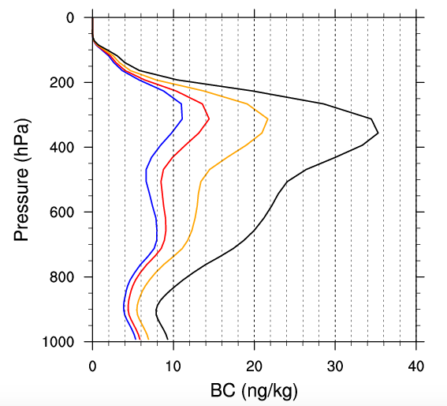
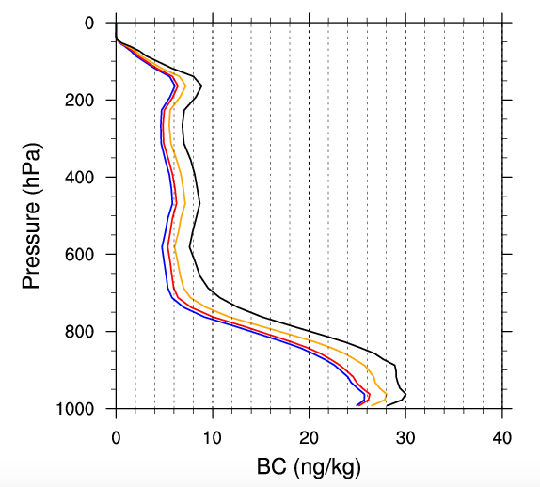
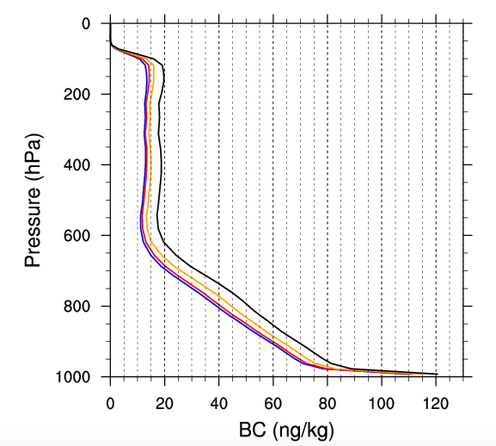
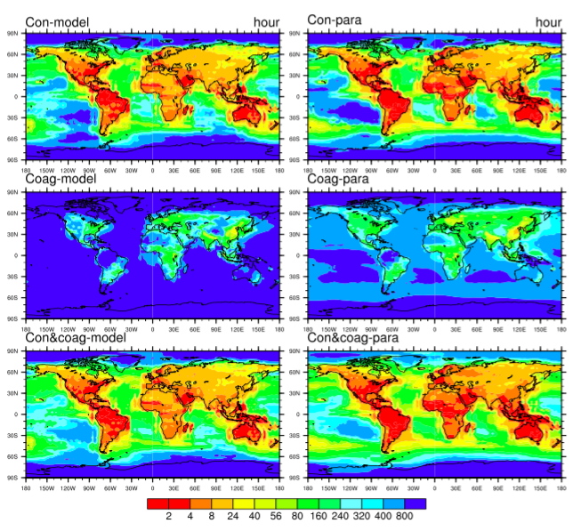
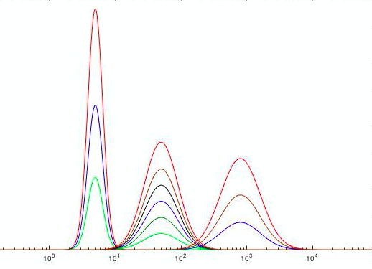
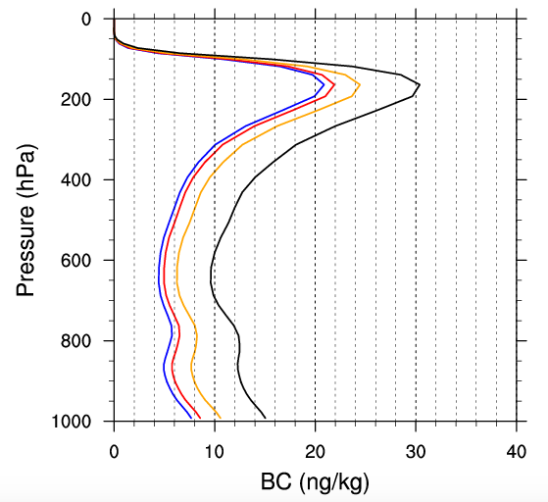
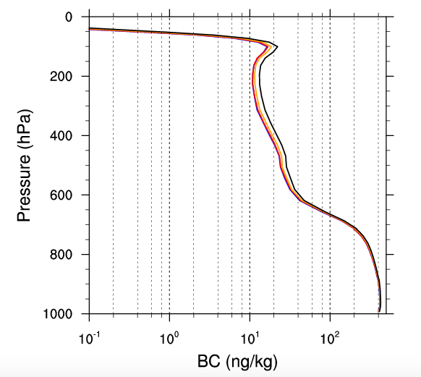
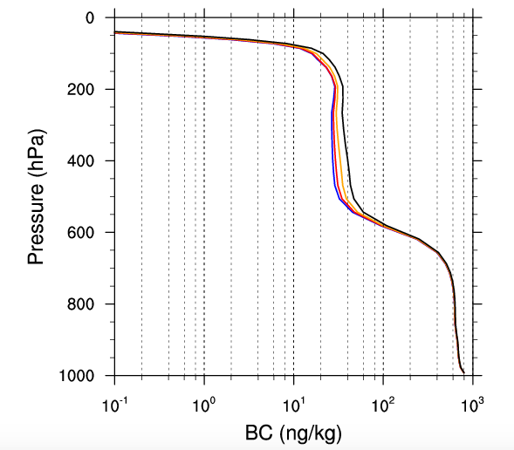
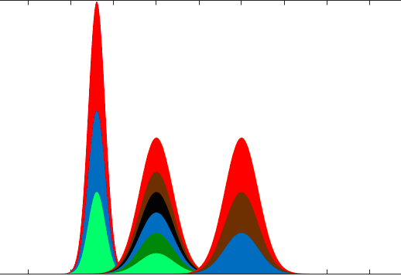
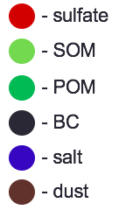
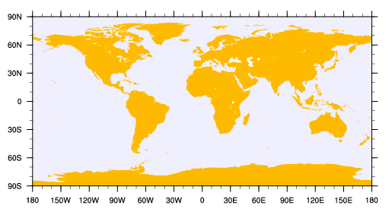
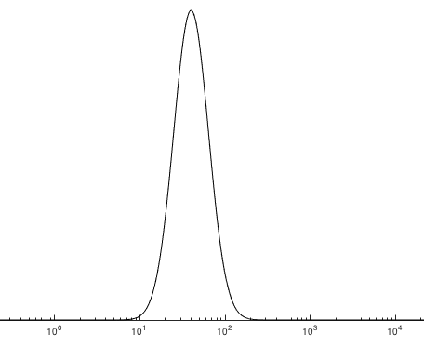
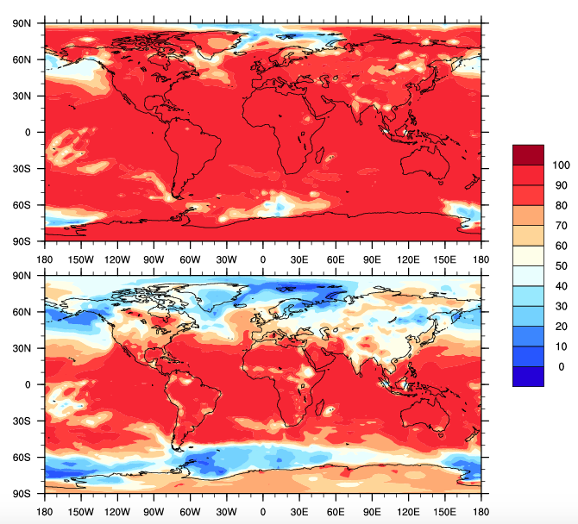
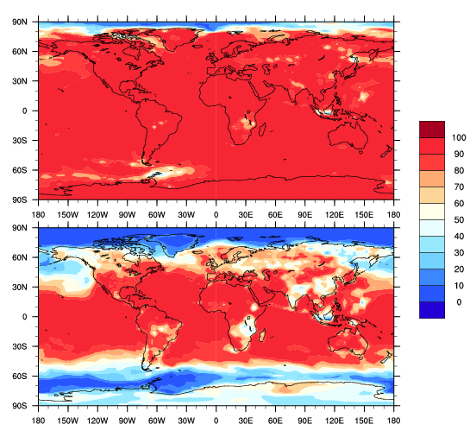
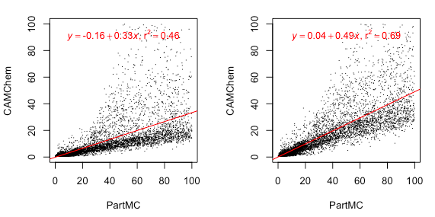
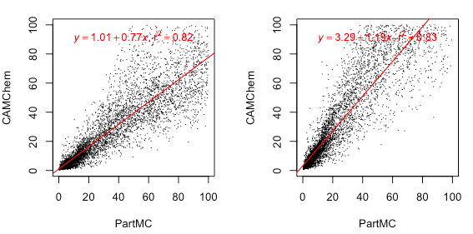
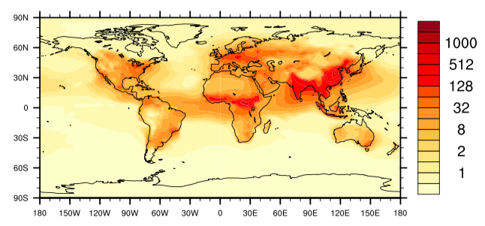
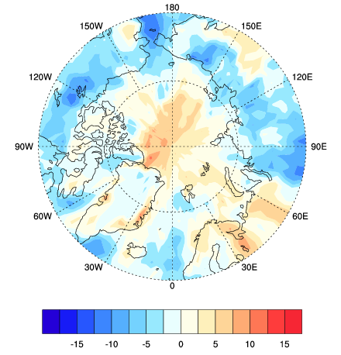
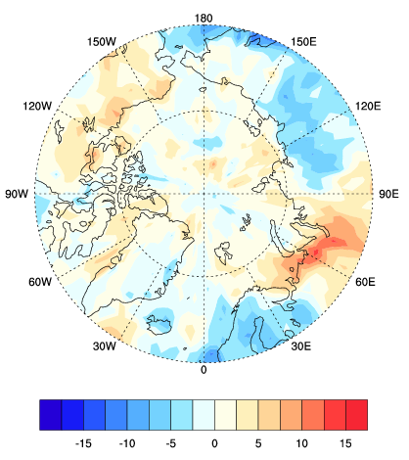
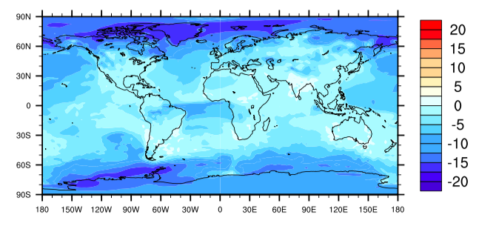

Sensitivity of Black Carbon Aging to Modeling Assumption in CAMChem
Yinrui Li¹, Nicole Riemer¹, Manvendra Krishna Dubey² , Allison C Aiken², Laura Fierce³, Donald Wuebbles¹
1. Department of Atmospheric Science, The School of Earth, Society & Environment , College of Liberal Arts and Sciences, University of Illinois at Urbana-Champaign
2. Earth and Environmental Sciences Division, Los Alamos National Laboratory， 3.Environmental and Climate Sciences Department, Brookhaven National Laboratory
Introduction
Method
Model Specifications
Modal Aerosol Model (MAM4) in CAMChem
Condensation: “Monolayer-of-sulfate criterion”
Results
1. BC Burden Sensitivity to Monolayer Criterion
2. BC Mixing State Sensitivity to Monolayer Criterion
3. BC Annual Direct Radiative Forcing – Arctic
4. Comparison of Annual Aging Timescales from CAMChem model and PartMC Parameterization
Scatter Plot of CAMChem and PartMC Aging Timescales
Monthly BC Vertical Profiles
Buseck and Posfai, 1999
March
CAMChem
PartMC
The ‘aging’ process of black carbon (BC)
Conversion of fresh, hydrophobic black carbon into aged, hydrophilic black carbon.
Directly contributing to CCN activation and wet removal.
Version: CESM1_2_2_CAMChem
Compset: MAM4 + interactive chemistry + offline meteorology
Time period: January 2010 – December 2010
1
2
4
8
1
2
3
September
BC Climate Effect
BC strongly absorbs visible light, ranked as the 2nd largest anthropogenic warming agent (1.1 W/m²) after CO₂ (1.6 W/m²). [1]
Large uncertainties (0.17 to 2.1 W/m²) exist in climate models. [1]
Limited understanding of aging is one key contribution to the uncertainties of estimating BC burden and climate effect.
1
2
3
10⁰ 10¹ 10² 10³ 10⁴
Aitken Accumulation Coarse
1
1 monolayer
2 monolayers
4 monolayers
8 monolayers
Coagulation
Condensation
2
3
hour
10⁰ 10¹ 10² 10³ 10⁴
Primary Carbon
Aging Process
condensation coagulation
BC Ratio in CAMChem (BC in Accumulation Mode/Total BC)
I_{cond}: total volume condensation rate over surface area. [2]
N: total aerosol number concentration. [2]
The equivalent of 8-monolayers of sulfate is needed to transfer material from the primary carbon mode (fresh) into the accumulation mode (aged).
March (992hPa) September (992hPa)
BC aging timescale computed from model transfer rate due to coagulation and condensation.
Goal: Aging in CAMChem and PartMC MOSAIC
CAMChem uses mechanistic aging rates, very sensitive to the choices of assumed parameters. [3]
Particle resolved model (PartMC-MOSAIC) estimates BC aging timescales more precisely by tracing the mass and composition of individual particles. [4]
PartMC-MOSIAC parameterization of BC’s aging can be applied to the output of CAMChem model to assess the accuracy of its aging criterion. [2]
BC core
L1
L1
L1
L2
8 monolayers of sulfate
monolayer depth = molecule diameter
%
L8
L8
L4
L8
Annual BC Mass Mixing Ratio (992hPa)
In the Arctic:
Most of BC is in primary carbon mode (externally mixed)!
L8 (default)
Conclusions
Simulated BC burden is most sensitive to the choices of aging criterion in the high-latitude regions, with maximum differences in the annually averaged BC mixing ratio of 16% near the surface.
Aging timescales range from less than one hour to several days.
Condensation of SOA and sulfate plays a dominating role in BC aging, compared to coagulation.
MAM4 aging timescales are broadly consistent with PartMC-MOSAIC aging timescales.
ng/kg
1 monolayer (992hPa) 8 monolayers (992hPa)
When using an 8-monolayer sulfate criterion, the aging timescales have the closest linear-regression slope to 1 and the highest R² value among four sensitivity cases.
Relative Difference (992hPa)
(L1– L8) / L8
References
Bond T., et al. J. Geophys. Res. Atmos., 118, 5380–5552, 2013.
Fierce, L, et al. Bull. Amer. Meteor. Soc. doi:10.1175/BAMS-D-16-0028.1, in press.
Liu, X., et al. Geosci. Model Dev., 5, 709–739, 2012.
Riemer, N et al. J. Aerosol Sci., 41(1):143–158, 2010.
Acknowledgement: This work was supported by the Center for Space and Earth Sciences, Los Alamos National Laboratory, Laboratory Directed Research and Development Program.
Relative differences are highest at high latitudes (distant from the sources).
%
L1: 1 monolayer; L8: 8 monolayers
W/m²
W/m²

